Slide 1
Real-world effectiveness of nicotine replacement therapy in pregnancy
Leonie S. Brose, PhD
Andy McEwen, PhD & Robert West, PhD
University College London and
National Centre for Smoking Cessation and Training

Slide 2
Background
Smoking in pregnancy in UK ¹
26% immediately before or during pregnancy
12% throughout and at delivery
Underreporting likely
Smoking in pregnancy increases risk of e.g. ²
Preterm birth
Placental abruption
Low birth-weight
Sudden infant death syndrome
Adult morbidities such as obesity, diabetes, asthma, mental health problems
Stopping smoking reduces increased risks
¹ NHS Information Centre, 2011
² USDHHS, 2004
Notes:
Underreporting likely
Low birth weight indicator for numerous health problems, including in adult life
Stopping reduces some of the risks
Reread references:
Maternal smoking during pregnancy is associated with a range of negative health consequences for the offspring. It is known to be associated with low birth-weight, increased perinatal mortality and sudden infant death syndrome (Agrawal et al., 2010; Officeof the Surgeon General: Office on Smoking and Health, 2004; US Department of Health and Human Services, 2001). It is an independent risk factor for obesity (Oken et al., 2008), early onset adult diabetes (Montgomery and Ekbom, 2002) and high blood pressure (Lawlor et al., 2004). Intrauterine exposure to maternal smoking is also associated with asthma and there is evidence that this is the case even in offspring of non-smoking mothers but who themselves were exposed in utero to maternal smoking, suggesting that smoking may induce genotoxicity (Li et al., 2005). Maternal smoking during pregnancy is associated with an increased risk of psychiatric morbidity and all cause mortality in childhood, adolescence and young adulthood (Ekblad et al., 2010).

Slide 3
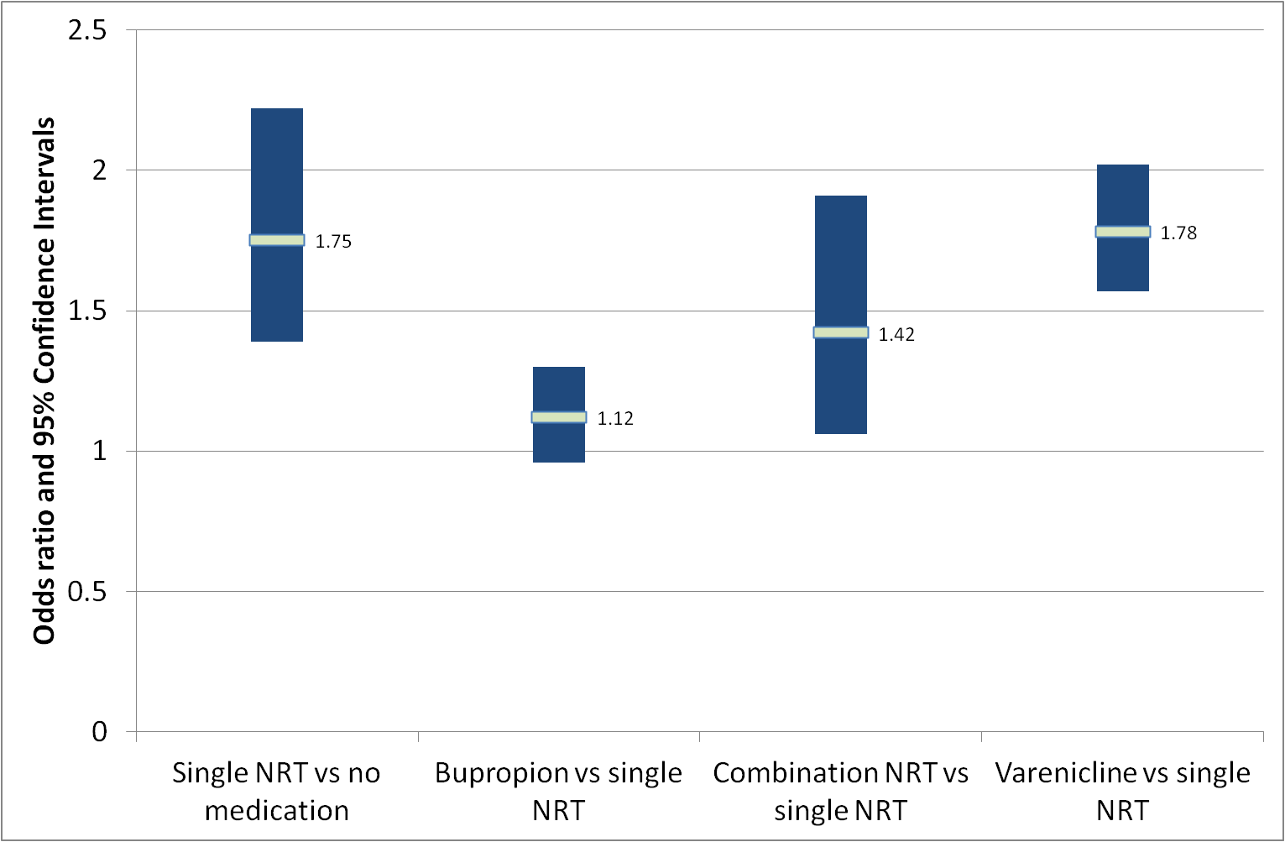
Background
In general population: Medication increases quit rates
Single nicotine replacement therapy (NRT)
Combination of two (or more) NRT products
Bupropion (Zyban)
Varenicline (Champix)
Brose et al, 2011, Thorax
Notes:
Commonly used medications in UK are
This shows so-called odds ratios: If the blue bar does not cross 1, we are confident that this option increases the odds of quitting compared with another option, in this case, the use of single NRT increases the odds of quitting compared with using no medication
In the general population, randomized controlled trials have shown such a combination of NRT products to be more efficacious than single NRT (RR = 1.34, 95% CI = 1.18–1.51 (Stead et al.,2012) and a similar advantage has been found in clinical practice (OR = 1.42, 95% CI = 1.06–1.91; Brose et al., 2011).

Slide 4
Background
Pregnancy: NRT can be used
Review of randomised controlled trials (RCTs) failed to find evidence for effectiveness ³
Evaluated single NRT, mostly nicotine patch
NHS Stop Smoking Services ⁴
Behavioural support and medication
Different types of support and range of settings
More than 20,000 pregnant women per year
Many use combination NRT
³ Coleman et al, Cochrane, 2012
⁴ NHS Information Centre, 2011
Notes:
Varenicline and bupropion not evaluated in pregnancy and not licensed for this population.
In UK, NRT can be used in pregnancy if it is judged to be necessary (DH, 2011), while the US does not recommend its use (Tobacco Use and Dependence Guideline Panel, 2008).
A systematic review of randomized controlled trials has found insufficient evidence to determine whether NRT in pregnancy is safe or effective, explains cautious guidelines.
Most trials evaluated nicotine patch and none combination NRT, which we know is more effective in general.
Additionally, nicotine more rapidly metabolized in pregnancy (Dempsey et al., 2002), theoretically making the same amount of NRT less effective
Services:
Support around 700,000 quit attempts each year. Offer behavioural support and medication
Type of behavioural support varies; most seen one-to-one, some in groups or in drop-ins (without appointment). Generally, groups have been found to be more effective than one-to-one interventions, while drop-ins appear to be less effective
Also range of settings, overall, specialist clinic settings have been found to be more effective than interventions set in primary care. (Bauld et al., 2010; Brose et al., 2011).
Now, among these 700k attempts are more than 20k by pregnant smokers (2010/11, 21k, 2011-12 , 26k)
Many use combination NRT
Unique opportunity to evaluate effectiveness

Slide 5
Objective and research questions
To assess the association of single and combination NRT with success of quit attempts of pregnant smokers in clinical practice while adjusting for smoker and treatment characteristics.
Are negative RCT findings for single NRT borne out in clinical practice?
Combination NRT has not been evaluated in RCTs; does it confer a benefit for smoking cessation in pregnant smokers?

Slide 6
Sample
N=315,721 treatment episodes
in 49 Services
April 2009 – June 2011
Identified as pregnant
N=9,587
Varenicline or bupropion (n=79)
Telephone support (n=438)
Missing age, sex, setting or support type (n=71)
N=8,999
(Sensitivity analysis)
Missing due date
Main analysis
N=3,880
Notes:
Of the 152 services in England, 58 were using this particular database at the time of the present audit and 49 agreed to share their anonymised data.
Excluded all with missing data on key information,
excluded all that were using other medication and those that received support over the phone because it is not usually possible to measure success in the same way.
Used 9000 cases for a sensitivity analysis
but main analysis based only on those with information on due date so that we could calculate how far along they were in the pregnancy
Main sample included 44 services (representative, not checked, but assume so)
Another sensitivity analysis not shown here

Slide 7
Methods
Dependence: Heaviness of Smoking Index (HSI) completed for 29%.
Differences between medications assessed separately.
Predictors
Medication (none, single NRT, combination NRT)
Treatment setting (specialist clinics, home visit, primary care, other)
Type of support (group, 1-to-1, drop-in, other)
Occupational grade (employed, not employed, student, unable to code)
Age
Months pregnant
Ethnicity (white, other)
Year of quit attempt
Outcome
CO-validated 4-week quit rates
Russell Standard (Clinical)
Clients lost to follow-up counted as smoking ⁵
⁵ West et al, Addiction, 2005
Notes:
Our outcomes were the same as the success definitions by the Department of Health, which is the Russell standard (Clinical).
Used biochemically validated 4-week outcome as outcome, 4 weeks after quit date client reports no smoking for at least two weeks and this is supported by a low amount of carbon monoxide in the expired air.
As is standard practice in smoking cessation research, everyone lost to follow-up was counted as not being abstinent, ie smoking.
Looked at outcomes in the medication groups and then took other predictors into account.
Adjusted for treatment setting and type of support and client characteristics (list), and also year of the quit attempt
HSI is a dependence measure based on number of cigarettes per day and time to first cigarette in the morning.
Only available for minority of clients, so not included but differences assessed separately

Slide 8
Methods
Two-level logistic regression models to assess effect of predictors on quit rates
Sensitivity analyses
Including those without months pregnant, n=8,999
Excluding all lost to follow-up, remaining n=2,887
Notes:
Used logistic regression to calculate the effect of each predictor on the outcome.
Treatment episodes within the same service share similarities, so to allow for this type of clustering or nesting, we used two-level models
(Level 2 was service and the medication effect was allowed to vary across services as a random effect)
Two sensitivity analysis, one mentioned earlier, second including only those who had been followed up, so excluding all those assumed to be smoking because of loss to follow-up

Slide 9
N=3,880 |  | No medication n=588 (15.2%) | Single NRT n=1166 (30.1%) | Combination NRT n=2126 (54.8%)
Age, Mean (SD) |  | 25.3 (6.0) | 25.7 (6.3) | 26.4 (6.1)
Months pregnant, Mean (SD) |  | 3.5 (2.1) | 4.3 (1.9) | 4.3 (1.8)
Ethnicity % (n)
 | White | 73.3 | 88.2 | 90.3
Occupational grade %
 | In employment | 24.1 | 38.6 | 41.6
 | Not in employment | 24.7 | 44.9 | 43.9
 | Unable to code | 48.5 | 11.1 | 10.1
Intervention setting %
 | Specialist clinic | 71.8 | 51.1 | 49.2
 | Home visit ª | 16.3 | 29.4 | 36.0
 | Primary care | 9.7 | 12.3 | 8.5
 | Other | 2.2 | 7.2 | 6.4
Intervention type %
 | One-to-one | 79.8 | 74.1 | 81.2
 | Group | 1.2 | 4.1 | 1.3
 | Other | 11.4 | 10.9 | 10.9
CO-validated 4-week quit % |  | 16.3 | 24.8 | 35.7
Lost to follow-up % |  | 29.4 | 31.7 | 21.2
^{a.} Provided by specialist practitioners in 75% of cases
Notes:
Look at the women in the three groups and their treatment
Biggest group received combination NRT
Mid-twenties, mostly white, beginning of second trimester
Largest group seen in specialist services, many also at home, usually by specialist practitioners, also some in primary care or other settings
As usual, most seen in 1-1 situation
Becomes interesting - quit rates.
Loss to follow up quite high, varied across groups, hence sensitivity analysis
All characteristics differ between the groups
(No medication may also have had medication, poorer quality of data recording as shown in larger proportion of ethnicity unknown and occupation unable to code etc.)

Slide 10
Predictors of CO-validated 4-week abstinence
2-level multivariable logistic regression, n=3,880 |  | Odds ratio (OR) | 95% Confidence interval (CI) | p value
Medication, reference: None
 | Single NRT | 1.06 | 0.60 to 1.86 | 0.84
 | Combination NRT | 1.93 | 1.13 to 3.29 | 0.02
Intervention setting, reference: Specialist clinic
 | Home visit | 1.16 | 0.89 to 1.51 | 0.28
 | Primary care | 0.57 | 0.41 to 0.79 | 0.001
 | Other setting | 1.00 | 0.70 to 1.42 | 0.98
Intervention type, reference: One-to-one
 | Group | 0.62 | 0.35 to 1.12 | 0.11
 | Drop-in | 0.58 | 0.42 to 0.82 | 0.002
 | Other | 0.97 | 0.69 to 1.36 | 0.85
Months pregnant, per month increase |  | 0.95 | 0.91 to 0.99 | 0.02
Also adjusted for ethnicity, age, occupational grade
Notes:
Odds ratio: above 1 indicates that for this group, the odds of quitting successfully are higher than for the comparison/reference group. If the Confidence Interval does not include 1, we are fairly confident that this difference is real.
Main result: Single NRT shows no benefit over no medication, but Combination NRT clear benefit.
Also interesting: Home visit not sig different from specialist clinics, same type of practitioner. Primary care really poor.
Usually, groups more effective than 1-1, not the case for pregnant women.
And quitting becomes less likely the closer it gets to the due date. So should get support to them early, or hardest cases left.
Two-level model with 3,880 individual cases as level 1 and 44 services as level 2. Effect of single NRT and dual form NRT allowed to vary across services.
Adjusted for:
Ethnicity: other or unknown compared with white: OR=0.86, 95% CI: 0.66 to 1.13, p=0.281
Age (per year increase): OR=1.02, 95% CI: 1.00 to 1.03, p=0.016
Occupational grade (compared with in employment): not in employment: OR=0.68, 95% CI: 0.58 to 0.81, p<0.001; full-time student: OR=0.61, 95% CI: 0.42 to 0.90, p=0.013; unable to code: OR=0.60, 95% CI: 0.46 to 0.79, p<0.001.

Slide 11
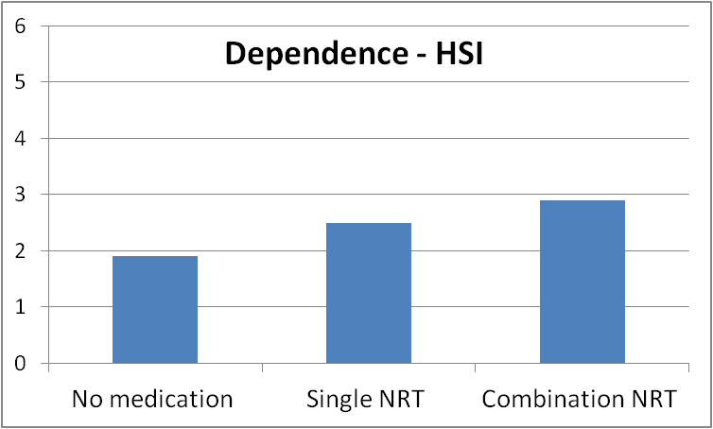
Further results
Sensitivity analyses
Including those without information on stage of pregnancy
Excluding all lost to follow-up
Results remain: Combination NRT benefit over no medication, single NRT no benefit.
Dependence
Those using combination NRT more dependent.
F(2,1124)=14.26, p<0.001
Notes:
Results of sensitivity:
If we exclude months pregnant as predictor, can use a bigger sample.
When using only those with a known outcome, smaller sample.
Encouragingly, the result remains the same
Dependence differed significantly, those using combination significantly more dependent than those without medication or single NRT.
HSI can range from 0 to 6, with higher values indicating higher dependence.
Higher dependence makes quitting more difficult,
So if it had been available for all patients and shown the same association, this means that the difference between combination NRT and the other options in terms of quit rates would have been even bigger.
n=1,127

Slide 12
Discussion
Single NRT shows no benefit - in line with RCTs
But combination NRT associated with success
Not due to differences in intervention or client characteristics, including dependence
Common non-specialist treatment (primary care) and later stage of pregnancy associated with worse outcomes
Limitation: Correlational design, but adjusted
Suggests need for full-scale RCT
Notes:
Combi NRT associated with higher success rates
Not explained by differences in intervention characteristics or client demographics, incl. dependence
The benefit for combination NRT remained after adjustment for demographics and intervention characteristics. This is particularly interesting as the group receiving combination NRT was further along in their pregnancy than those receiving no medication and the available data also suggest a higher level of dependence, i.e. those on combination NRT had characteristics that were associated with less successful quit attempts here and in previous research
Support in primary care associated with lower success rates, as were attempts in later stages of pregnancy, suggests that women should be supported as early as possible by trained specialists.
A main limitation of this study is that it is based on correlational observational data, but adjusted for key variables associated with outcome
These data suggest the need for a full-scale RCT of combination NRT in pregnancy
(Partner smoking status was not recorded and this may influence outcomes (Schneider et al.,2010) but there is no reason to believe that this would be associated with choice of combination NRT)

Slide 13
Discussion
First evidence on combination NRT in pregnancy
Exposes foetus to higher levels of nicotine than single NRT or stopping all use of nicotine, but:
Other options associated with resumed smoking
NRT delivers nicotine without carbon monoxide and other reproductive toxins in cigarettes
High-quality evidence-based behavioural support ^{6,7} should be provided regardless of medication
⁶ Lumley et al, Cochrane, 2009
⁷ Lorencatto et al, NTR, 2012
Notes:
This is the first large study on combination NRT in pregnancy
One common criticism or concern is that it exposes foetus to higher levels of nicotine than single NRT or stopping all use of nicotine, but
Associated with resumed smoking which will be far more harmful, because NRT delivers..
multitude of
Importantly, medication is only one part of the quit attempt. Evidence-based behavioural support has been shown to increase pregnant smokers’ chances of stopping successfully (Lumley et al., 2009). Specific behaviour change techniques have been associated with effective support (Lorencatto et al., 2012) and should be delivered to all pregnant smokers attempting to stop regardless of the medication option chosen.

Slide 14
Conclusions
Use of a combination of nicotine transdermal patch and a faster acting form of nicotine replacement therapy appears to confer a benefit in terms of promoting smoking cessation during pregnancy.
While this conclusion is based on observational data, it lends support to this treatment option pending confirmation by a randomised controlled trial.

Slide 15
Thank you
www.ncsct.co.uk
leonie.brose@ncsct.co.uk

